Slide 1

PIP2001 Capstone Project
Review - 4
Birth/Death Registration Integration With Services
Batch Number:
Roll Number | Student Name
20211CSE0289 | BHARGAVI S
20211CSE0745 | KIRAN KUMAR KC
20211CSE0629 | RAHUL GOWDA V
Under the Supervision of,
Mr.Ramesh T
Professor / Associate Professor / Assistant Professor
School of Computer Science and Engineering
Presidency University
Name of the Program: CSE
Name of the HoD: Dr. Blessed Prince P
Name of the Program Project Coordinator: Mr. Amarnath J.L & Dr. Jayanthi. K.
Name of the School Project Coordinators: Dr. Sampath A K / Dr. Abdul Khadar A / Mr. Md Ziaur Rahman

Slide 2
Content
Introduction
Literature Review
Existing method Drawback
Proposed Method
Methodology/Modules
Architecture diagram
Hardware/software components
Timeline of the Project
Expected Outcomes
Conclusion
Github Link
References
Publication details
Project work mapping with SDG

Slide 3
Introduction
The birth and death registration process is a crucial aspect of civil governance, providing an official record of vital events that impact social, legal, and economic rights. In India, the process has traditionally been manual, requiring multiple visits to government offices. This project aims to integrate services related to birth and death registration into a unified mobile app to streamline processes like registering births and notifying tear-down services upon death (e.g., bank accounts, insurance, pensions). Such an integration will enhance efficiency, reduce administrative burdens, and ensure timely service delivery.

Slide 4
Literature Review
A. "Design and Implementation of a Birth and Death Registration System" (O. Oluwaseun, E. Dr. O. O. Shoewu, and L. A. Akinyemi, 2022)
This research discusses the design of an automated birth and death registration system. It highlights how automation can improve efficiency in recording vital events, reducing the manual workload for both hospitals and municipal offices. The system integrates with governmental databases, ensuring that records are updated in real-time.
Takeaway: Automation of the registration process is key to improving service delivery and reducing errors caused by manual inputs.

Slide 5
Literature Review
B. "mSIGA: Mobile Application for Birth and Death Registration in Hospitals and Remote Population Areas" (R. Pinto, J. S. Pinto, and R. J. Oliveira, 2018)
mSIGA is a mobile-based solution developed to facilitate birth and death registration in hospitals, especially in remote areas. The app allows real-time registration, overcoming the challenge of accessing distant municipal offices. It also integrates with other health and government services, improving the availability of vital records.
Takeaway: Mobile solutions help streamline registration in under-served areas and ensure timely notifications to relevant stakeholders.

Slide 6
Literature Review
C. "An Assessment of Birth Registration System and Factors Affecting in India and its States" (N. Kumari, 2019)
This paper explores the challenges faced by India’s birth registration system, including rural-urban discrepancies, lack of awareness, and the burden on municipal authorities. The research calls for more comprehensive digital solutions that address these issues and create equitable access to registration services.
Takeaway: Digital integration of birth and death registration can reduce disparities in access and improve compliance with legal requirements.

Slide 7
Existing method Drawback
Manual Entry: In many areas, people need to visit the municipal office several times for registering births or deaths, which can lead to delays and mistakes.
Disconnected Services: There’s no system to automatically notify services (like banks, insurance, or pensions) when someone passes away. Families have to inform each service manually, which takes time and can be easily missed.
Inconsistent Systems: Different places in India use different methods and levels of technology, causing inefficiencies and differences in how the data is handled.

Slide 8
Proposed Method
The proposed solution is a unified mobile/web-based system for automating and integrating the registration of births and deaths with the relevant services:
Birth Registration: The system will integrate with maternity homes and hospitals, allowing them to directly report births to the municipal office. Parents will receive a notification to enter their child's name online, after which a birth certificate will be generated and sent electronically.
Death Registration: Hospitals or funeral homes will report deaths to the municipal office. The system will automatically notify banks, insurance companies, pension services, and government departments to update the individual’s status.
Tear-Down Notification: Upon death, the system will trigger notifications to all related services to terminate or transfer benefits, accounts, and policies linked to the deceased.

Slide 9
Objectives
Simplify birth and death registration through an integrated, digital system.
Reduce manual errors by automating the registration process and linking services.
Provide timely notifications to various government and private institutions upon an individual’s birth or death.
Offer a user-friendly platform for citizens to access and track birth/death registrations.

Slide 10
Methodology/Modules
Module 1: Birth Registration
Hospital Integration: Hospitals enter birth details directly into the system.
User Input: Parents add the child’s name via app or web portal.
Certificate Generation: The system sends a digital birth certificate to parents.
Module 2: Death Registration
Hospital/Funeral Home Entry: They enter death details.
Notification System: Notifications are sent to institutions (banks, insurance, government) to update records.

Slide 11
Methodology/Modules
Module 3: Tear-Down Notification
Automated Notifications: Upon death registration, the system sends alerts to services to update or terminate accounts.
Module 4: User Interface
Web/Mobile App: Users can track registration status and receive updates via SMS, email, or app.

Slide 12
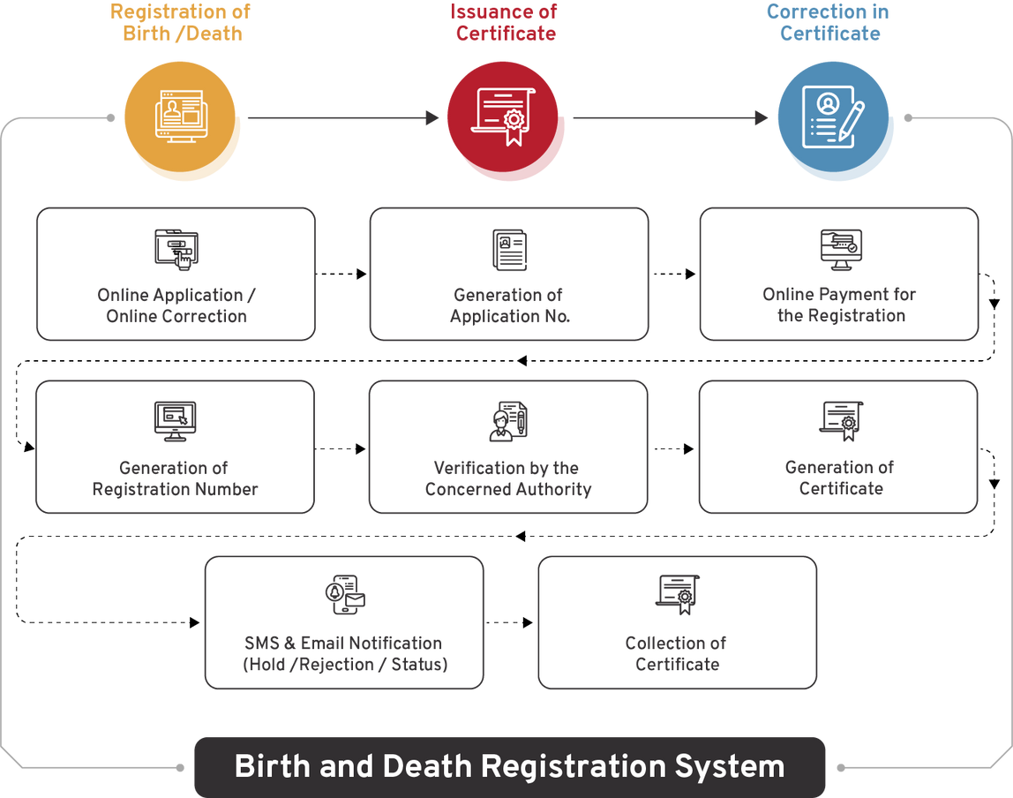
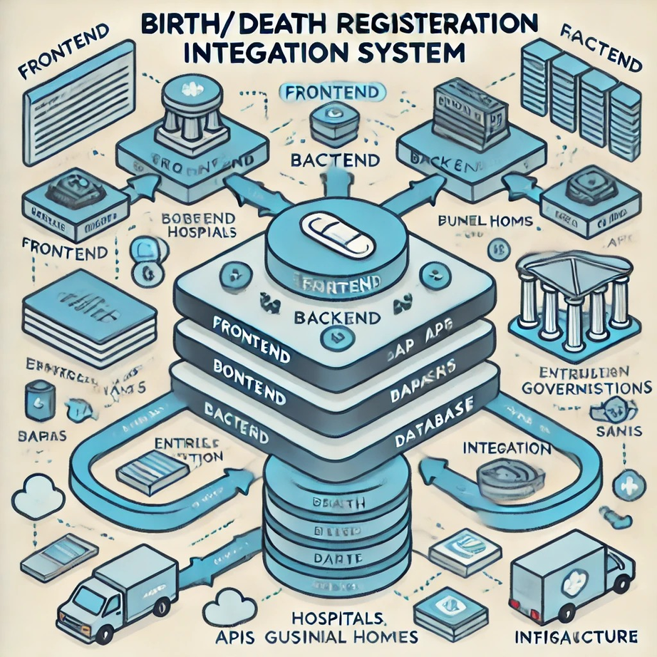
Architecture diagram

Slide 13
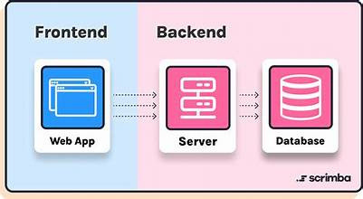
Analysis of Problem Statement (contd...)
Software Requirements:
Frontend: Mobile app for registration, status tracking, notifications, certificates
Backend: Manage submissions, integrate databases, handle notifications
Database: Store records and user data
APIs: RESTful for data handling

Slide 14
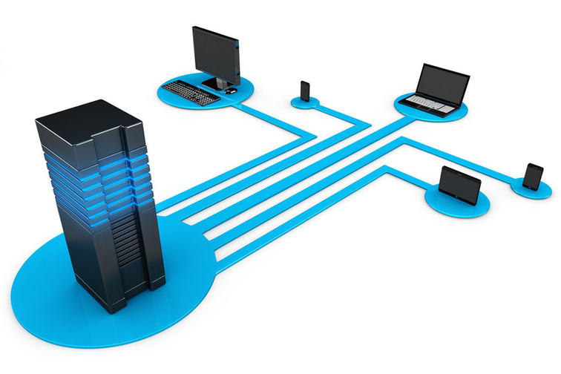
Analysis of Problem Statement (contd...)
Hardware Requirements:
Servers: For backend processing and data management
Network Infrastructure: For connectivity and communication
Devices: For user access and testing (e.g., mobile devices, computers)

Slide 15
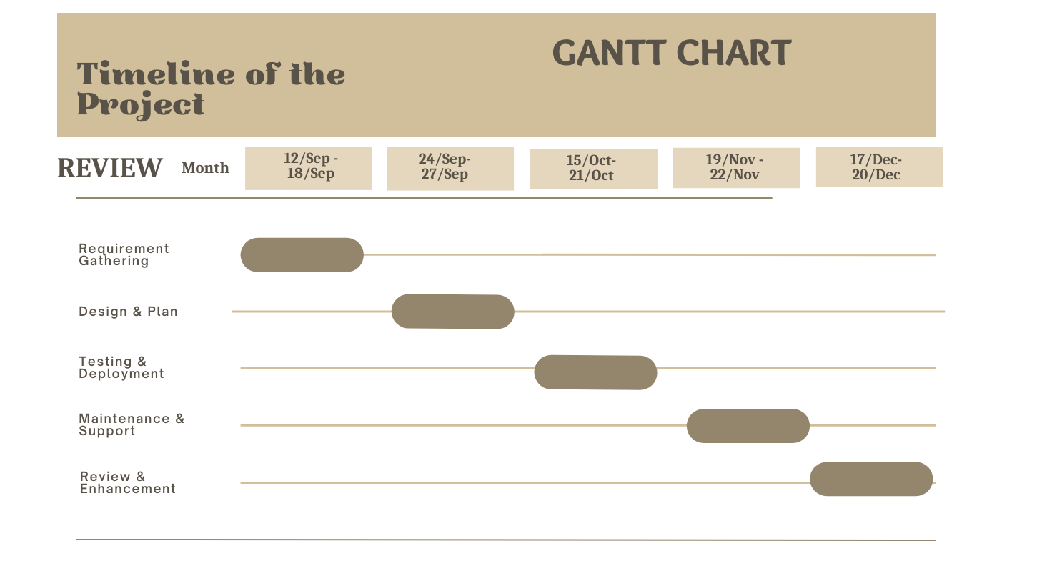
Timeline of the Project (Gantt Chart)

Slide 16
Expected Outcomes
A fully functional digital platform that automates birth and death registrations.
Timely issuance of birth and death certificates to citizens.
Seamless notification of government and financial institutions about changes in an individual’s status, reducing delays and preventing fraud.

Slide 17
Conclusion
The project will revolutionize the current birth and death registration processes by introducing a digital, integrated system that links these vital events with various services. The system will reduce the administrative burden on citizens and institutions, improve accuracy, and ensure timely service delivery.

Slide 18
Github Link
The Github link provided should have public access permission.
https://github.com/BhargaviShankar123/Birth-Death-Registration-Integration-With-Services-

Slide 19
References
Verma, A., & Gupta, R. (2024). "Integrating AI in Birth and Death Registration Systems: A Path Towards Improved Service Delivery." International Journal of Public Health Research, 14(1), 1-10. Link
Srinivasan, K., & Suresh, S. (2023). "Analysis of Digital Systems for Birth and Death Registration in India: Challenges and Future Directions." International Journal of Health Systems and Services, 3(1), 20-28. Link
Oluwaseun, O., Shoewu, E. O. O., & Akinyemi, L. A. (2022). "Design and implementation of a birth and death registration system." IEEE. Link
Dey, S., & Mukherjee, A. (2023). "The Role of Mobile Applications in Improving Birth and Death Registration in Rural Areas: A Case Study." International Journal of Information Systems for Crisis Response and Management, 15(2), 45-58. Link
Banerjee, S., & Singh, V. (2022). "Smart Birth and Death Registration: An Integrated Approach." International Journal of Computer Applications, 182(31), 7-12. Link
Khan, N. A., & Ali, H. (2020). "A Comprehensive Review on Birth and Death Registration in India: Challenges and Opportunities." International Journal of Health and Medical Sciences, 6(2), 45-50. Link
Ranjan, A. (2020). "Challenges in Birth and Death Registration: A Review of Literature and Suggestions for Policy." Journal of Health Policy and Planning, 35(8), 982-989. Link
Mansoor, S., & Kumari, N. (2020). "Digital Innovations in Civil Registration: A Review." International Journal of Advanced Research in Computer Science, 11(5), 1-5. Link
Kumari, N. (2019). "An Assessment of Birth Registration System and Factors Affecting in India and its States." Online Journal of Public Health Informatics, 11(1). Link
Pinto, R., Pinto, J. S., & Oliveira, R. J. (2018). "mSIGA: Mobile application for birth and death registration in hospitals and remote population areas." University of Aveiro. Link

Slide 20
Publication Details
Title: Birth/Death Registration Integration with Services
Journal: International Journal of Research and Analytical Reviews (IJRAR)
Year: 2024-12-12 04:51:17
PAPER ID: IJRAR24D2804
UGC Approval: UGC Approved Journal No: 43602
Volume: 11
Issue: 4
Pages: 212-214
Published URL : http://www.ijrar.org/viewfull.php?&p_id=IJRAR24D2804

Slide 21

Project work mapping with SDG
SDG 16: Peace, Justice, and Strong Institutions: By providing a transparent, efficient civil registration system, the project ensures timely access to legal and social services.
SDG 10: Reduced Inequality: The mobile-based solution ensures that all individuals, regardless of location, can access registration services, reducing disparities between rural and urban populations.

Slide 22


